Slide 1
Application—Storage Discovery
Nikolai Joukov, Birgit Pfitzmann, HariGovind Ramasamy, Murthy Devarakonda
IBM T.J. Watson Research Center
Services Research

Slide 2
Typical IT optimization scenario
B
Transformation Cost
Cost
A
Steady-State Cost Benefit
C
Transformation
Time

Slide 3
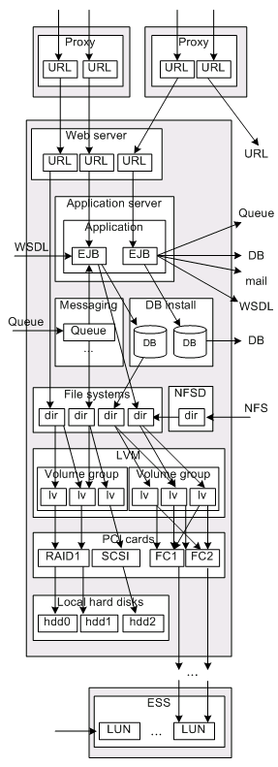
Why do we need IT discovery?

Slide 4
Galapagos overview
IT optimization and maintenance tasks need knowledge of dependencies between software/servers/data/business-level
  Even when application owners think they know what they manage, there are always “surprises”
Galapagos discovers fine-grained static application dependencies
  E.g., URLs, App servers, EJBs, Databases, Message Queues
Needs no accounts and no extra software on the servers
  Fast overall discovery, typically days from initial discussions
Being used commercially by IBM services teams
NEW

Slide 5
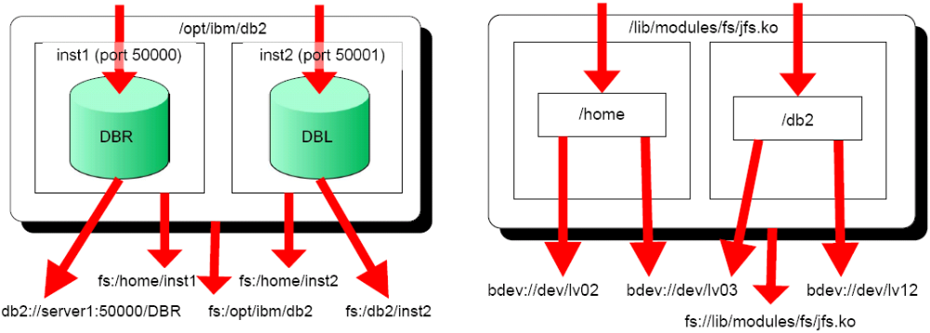
Galapagos Software Models
Each per-software sensor builds a specific model (e.g., for DB2 or JFS) based on:
  configuration data
  logs
  available monitoring
Models get connected together via “URLs”

Slide 6
Galapagos Architecture
parser that processes logs and configuration files and correlates information
ask system admins to execute
per-server TAR file
SH, VBS scripts to collect configuration, log, and connectivity data
simple, portable, reliable

Slide 7
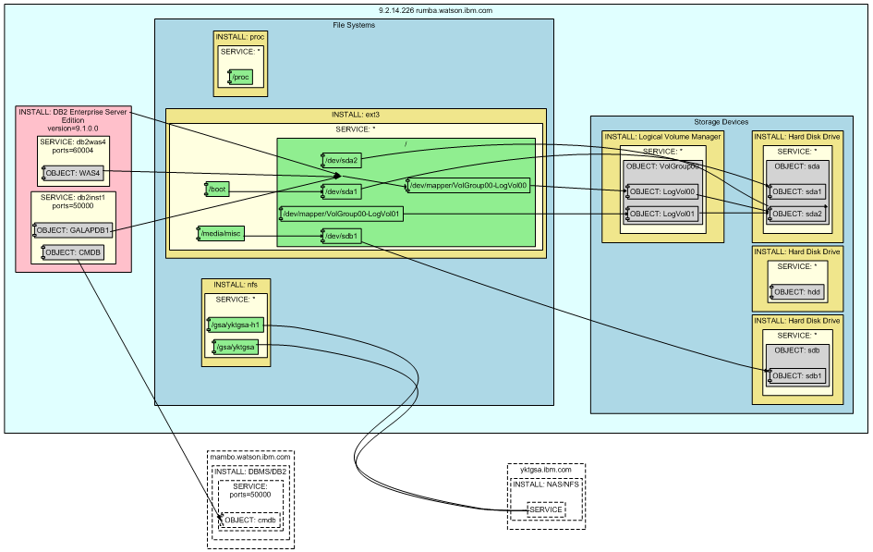
Linux Server DB2-to-Storage Picture Example (simplified)
DB2, two instances, databases
LVM install, volume groups, volumes
SCSI disk, partitions
Ext3 mounts
NFS mounts
unused, not partitioned IDE disk
DB2 on another server that we did not scan
another SCSI disk and partition
NFSD on another server that we did not scan

Slide 8
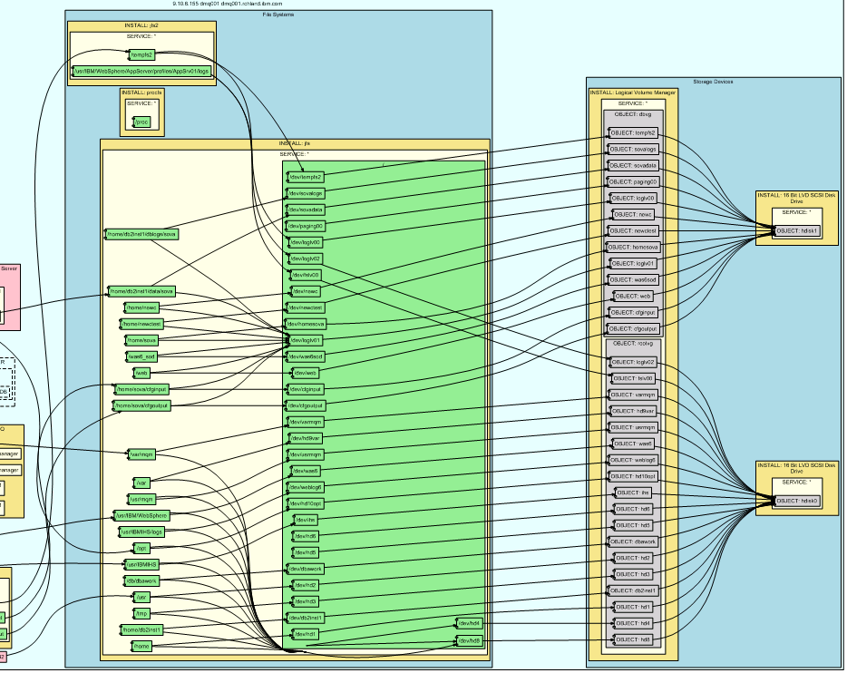
AIX Storage Stack Discovery Example
File systems (local and network)
Logical devices
LVM
Local hard disks
Databases and other software not shown here
Could be SAN connections

Slide 9
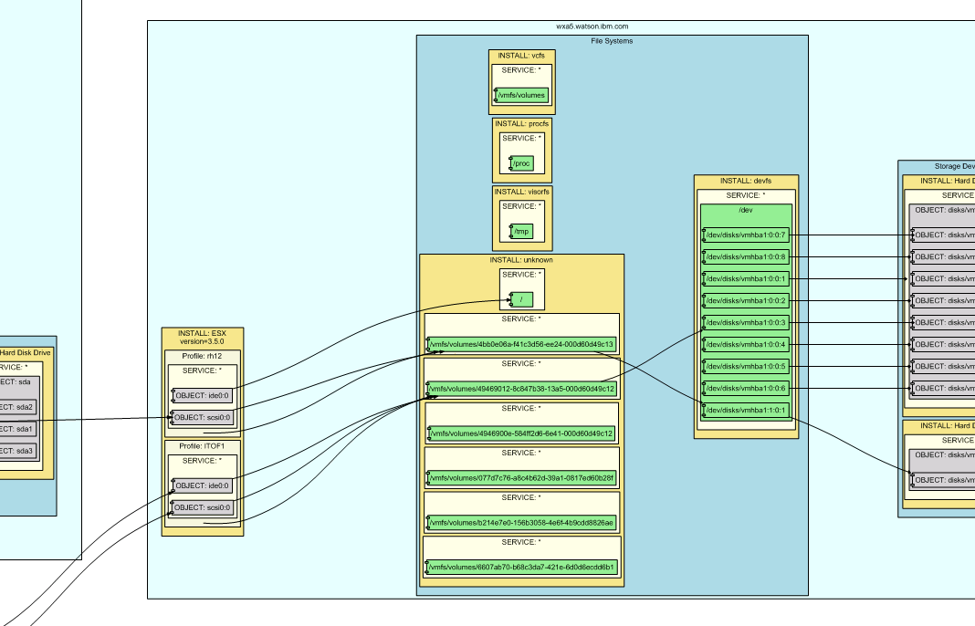

VMware ESX Client VM (left) and Server (center)

Slide 10
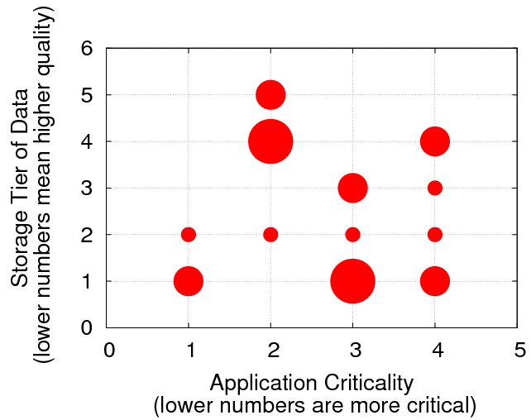
Example Use Case: Business Data Criticality vs. Storage Tier
(30 production AIX servers)
One local disk
Local disks with software mirroring
Hardware RAID
Enterprise Storage Systems

Slide 11
Example Use Case: Disk Consolidation
(30 production AIX servers)
x100 disk power reduction opportunities by virtualization
Size (GB) | Used (#) | Unused (#) | System (#)
4 | 7 | 13 | 2
9 | 40 | 5 | 16
18 | 73 | 0 | 6
36 | 29 | 5 | 18
73 | 29 | 2 | 12
Total: | 178 | 21 | 54
spinning but unused disks – recommend SAs to power down

Slide 12
Example Use Case: Database Storage Space Reorganization
(270 AIX, 21 HP-UX, 2 Windows production servers)
DB2, Oracle, Sybase, PostgreSQL, MySQL, Microsoft SQL DBs
EMC shared storage
>200 file systems with tablespaces 100% full – unoperational databases
Databases (#) | 1,076
Size (TB) | 151.7
Size Old (TB) | 0.4
Unused (TB) | 50.3
Tablespaces not used for 2 months or more
Tablespace space allocated but not used

Slide 13
Example Use Case: Network File Systems Usage
(30 production AIX servers)
Usage Type | Clients | Servers
Homes | 14 | 0
Application Data | 7 | 7
Bulk Data | 3 | 5
only a few servers depend on NFS performance

Slide 14
Conclusions
Method and tool to discover application to storage dependencies
  non-intrusive
  no accounts necessary
  fine-grain data objects (e.g., files, URLs, tables)
Ran on many thousands, presented results for 323 production servers
Demonstrated a few examples of discovery-based optimization:
  Alignment of storage tiers and data criticality
  Elimination of unused disks and consolidation of small disks
  Database storage reorganization
We believe that the only realistic alternative is manual discovery, which is error-prone and expensive

Slide 15
Thank you
Application-Storage Discovery
Nikolai Joukov, Birgit Pfitzmann,
HariGovind Ramasamy, Murthy Devarakonda
IBM T.J. Watson Research Center

